Slide 1
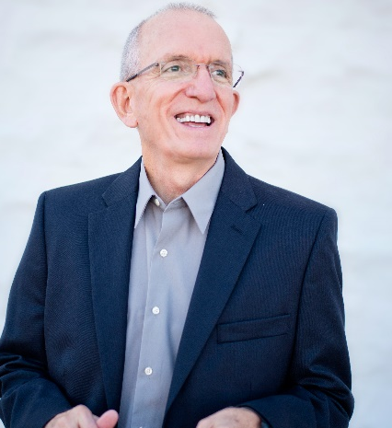
Tony Brigmon
Former Face of Southwest Airlines culture as their "Ambassador of FUN“; 2000+ presentations
Awarded Southwest Airlines President’s Award (out of 2000+ employees)
A pioneer of the positivity movement in business
Author of ​“The Funomenal ™​ Workplace”
www.tonybrigmon.com 469-826-8792
Notes:
Two reasons: 1. I love watching Tony do what he does. ->

